Slide 1
Partnering for a Sustainable Ocean: The Role of Regional Ocean Governance in Implementing SDG14
International Oceans Institute Hong Kong
26 April 2017
Glen Wright
glen.wright@iddri.org

Slide 2








Slide 3
Key messages
Importance of regional partnerships and cooperation in implementing SDG14
Regional ocean governance initiatives are already making a difference
Need to build engagement at the regional level
Notes:
In this slide we present a schema for how the cycle could work – and for example how and when the mechanism for the transparency of action can feed into the cycle.
The process starts with the contributions that countries are currently preparing, framed and supported by the regime on means of implementation.
Once contributions are prepared, there would be a process to assess the adequacy of the contributions. It should be noted that this process can probably take place both inside and outside the UNFCCC. There should be a consultation in the UNFCCC, as many have proposed. It’s an open question whether there will be time and political scope for more before Paris. But there will also be researchers and experts that can help us to form an idea of the collective and individual adequacy of contributions. It’s also an open question of whether this process could result in revisions to contributions in T1.
Once determined, contributions would be implemented and there would be a process to ensure the transparency of action.
It is important to consider the implications of a short ‘contribution cycle’ for the role of the transparency process. Imagine we have a very short cycle of contributions, for example every 5 years. That means that we are back at the table well before the current period has ended (or indeed started). This is the case we have now, negotiating in 2015 contributions for post 2020, before the pre 2020 period has finished.
A key issue therefore becomes how can the transparency of action process also look forward to provide useful information for subsequent rounds of collective action?
The final step in the cycle is a process of collective and individual learning that would provide an input into the next round of contributions. This could combine elements of capacity building and facilitation, in order to help countries better prepare subsequent contributions, as well as identify on-going successes and difficulties in implementing the current period.
It should be noted that we don’t speak here of compliance. Conceptually, this could be kept separate from the learning and problem solving process. Certainly, it may be useful to have a clear, independent vision ex post of whether a contribution has been achieved, as a minimum. That is a topic for this afternoon.

Slide 4
PROG report
Background and history of regional ocean governance
Overview of different mechanisms
Target-by-target analysis with case studies
Partnership case studies
Overarching issues, e.g. finance, capacity development
Notes:
In this slide we present a schema for how the cycle could work – and for example how and when the mechanism for the transparency of action can feed into the cycle.
The process starts with the contributions that countries are currently preparing, framed and supported by the regime on means of implementation.
Once contributions are prepared, there would be a process to assess the adequacy of the contributions. It should be noted that this process can probably take place both inside and outside the UNFCCC. There should be a consultation in the UNFCCC, as many have proposed. It’s an open question whether there will be time and political scope for more before Paris. But there will also be researchers and experts that can help us to form an idea of the collective and individual adequacy of contributions. It’s also an open question of whether this process could result in revisions to contributions in T1.
Once determined, contributions would be implemented and there would be a process to ensure the transparency of action.
It is important to consider the implications of a short ‘contribution cycle’ for the role of the transparency process. Imagine we have a very short cycle of contributions, for example every 5 years. That means that we are back at the table well before the current period has ended (or indeed started). This is the case we have now, negotiating in 2015 contributions for post 2020, before the pre 2020 period has finished.
A key issue therefore becomes how can the transparency of action process also look forward to provide useful information for subsequent rounds of collective action?
The final step in the cycle is a process of collective and individual learning that would provide an input into the next round of contributions. This could combine elements of capacity building and facilitation, in order to help countries better prepare subsequent contributions, as well as identify on-going successes and difficulties in implementing the current period.
It should be noted that we don’t speak here of compliance. Conceptually, this could be kept separate from the learning and problem solving process. Certainly, it may be useful to have a clear, independent vision ex post of whether a contribution has been achieved, as a minimum. That is a topic for this afternoon.

Slide 5
Regional ocean governance (1)
Transboundary nature of marine resources & threats to the marine environment present unique challenges:
cannot be tackled effectively by States acting individually
implies a responsibility for national governments to collaborate to achieve SDG14
UNCLOS, Article 197: encourages States to cooperate “as appropriate, on a regional basis, directly or through competent international organisations for the protection and preservation of the marine environment, taking into account characteristic regional features”
Highlighted in the 2030 Agenda
Notes:
In this slide we present a schema for how the cycle could work – and for example how and when the mechanism for the transparency of action can feed into the cycle.
The process starts with the contributions that countries are currently preparing, framed and supported by the regime on means of implementation.
Once contributions are prepared, there would be a process to assess the adequacy of the contributions. It should be noted that this process can probably take place both inside and outside the UNFCCC. There should be a consultation in the UNFCCC, as many have proposed. It’s an open question whether there will be time and political scope for more before Paris. But there will also be researchers and experts that can help us to form an idea of the collective and individual adequacy of contributions. It’s also an open question of whether this process could result in revisions to contributions in T1.
Once determined, contributions would be implemented and there would be a process to ensure the transparency of action.
It is important to consider the implications of a short ‘contribution cycle’ for the role of the transparency process. Imagine we have a very short cycle of contributions, for example every 5 years. That means that we are back at the table well before the current period has ended (or indeed started). This is the case we have now, negotiating in 2015 contributions for post 2020, before the pre 2020 period has finished.
A key issue therefore becomes how can the transparency of action process also look forward to provide useful information for subsequent rounds of collective action?
The final step in the cycle is a process of collective and individual learning that would provide an input into the next round of contributions. This could combine elements of capacity building and facilitation, in order to help countries better prepare subsequent contributions, as well as identify on-going successes and difficulties in implementing the current period.
It should be noted that we don’t speak here of compliance. Conceptually, this could be kept separate from the learning and problem solving process. Certainly, it may be useful to have a clear, independent vision ex post of whether a contribution has been achieved, as a minimum. That is a topic for this afternoon.

Slide 6
Regional ocean governance (2)
Takes many forms, including:
Regional Seas Conventions and Action Plans
Regional Fisheries Bodies
Political and economic organisations
Leader-driven initiatives
Large Marine Ecosystem (LME) projects
Notes:
In this slide we present a schema for how the cycle could work – and for example how and when the mechanism for the transparency of action can feed into the cycle.
The process starts with the contributions that countries are currently preparing, framed and supported by the regime on means of implementation.
Once contributions are prepared, there would be a process to assess the adequacy of the contributions. It should be noted that this process can probably take place both inside and outside the UNFCCC. There should be a consultation in the UNFCCC, as many have proposed. It’s an open question whether there will be time and political scope for more before Paris. But there will also be researchers and experts that can help us to form an idea of the collective and individual adequacy of contributions. It’s also an open question of whether this process could result in revisions to contributions in T1.
Once determined, contributions would be implemented and there would be a process to ensure the transparency of action.
It is important to consider the implications of a short ‘contribution cycle’ for the role of the transparency process. Imagine we have a very short cycle of contributions, for example every 5 years. That means that we are back at the table well before the current period has ended (or indeed started). This is the case we have now, negotiating in 2015 contributions for post 2020, before the pre 2020 period has finished.
A key issue therefore becomes how can the transparency of action process also look forward to provide useful information for subsequent rounds of collective action?
The final step in the cycle is a process of collective and individual learning that would provide an input into the next round of contributions. This could combine elements of capacity building and facilitation, in order to help countries better prepare subsequent contributions, as well as identify on-going successes and difficulties in implementing the current period.
It should be noted that we don’t speak here of compliance. Conceptually, this could be kept separate from the learning and problem solving process. Certainly, it may be useful to have a clear, independent vision ex post of whether a contribution has been achieved, as a minimum. That is a topic for this afternoon.

Slide 7
Tackling SDG14 targets at the regional level
Marine pollution
Sustainable management and protection
Ocean acidification
Sustainable fisheries
Conservation
Fisheries subsidies
SIDS and LDCs
Knowledge, capacity building & technology transfer
Artisanal fisheries
Implementation of international law
Notes:
In this slide we present a schema for how the cycle could work – and for example how and when the mechanism for the transparency of action can feed into the cycle.
The process starts with the contributions that countries are currently preparing, framed and supported by the regime on means of implementation.
Once contributions are prepared, there would be a process to assess the adequacy of the contributions. It should be noted that this process can probably take place both inside and outside the UNFCCC. There should be a consultation in the UNFCCC, as many have proposed. It’s an open question whether there will be time and political scope for more before Paris. But there will also be researchers and experts that can help us to form an idea of the collective and individual adequacy of contributions. It’s also an open question of whether this process could result in revisions to contributions in T1.
Once determined, contributions would be implemented and there would be a process to ensure the transparency of action.
It is important to consider the implications of a short ‘contribution cycle’ for the role of the transparency process. Imagine we have a very short cycle of contributions, for example every 5 years. That means that we are back at the table well before the current period has ended (or indeed started). This is the case we have now, negotiating in 2015 contributions for post 2020, before the pre 2020 period has finished.
A key issue therefore becomes how can the transparency of action process also look forward to provide useful information for subsequent rounds of collective action?
The final step in the cycle is a process of collective and individual learning that would provide an input into the next round of contributions. This could combine elements of capacity building and facilitation, in order to help countries better prepare subsequent contributions, as well as identify on-going successes and difficulties in implementing the current period.
It should be noted that we don’t speak here of compliance. Conceptually, this could be kept separate from the learning and problem solving process. Certainly, it may be useful to have a clear, independent vision ex post of whether a contribution has been achieved, as a minimum. That is a topic for this afternoon.

Slide 8
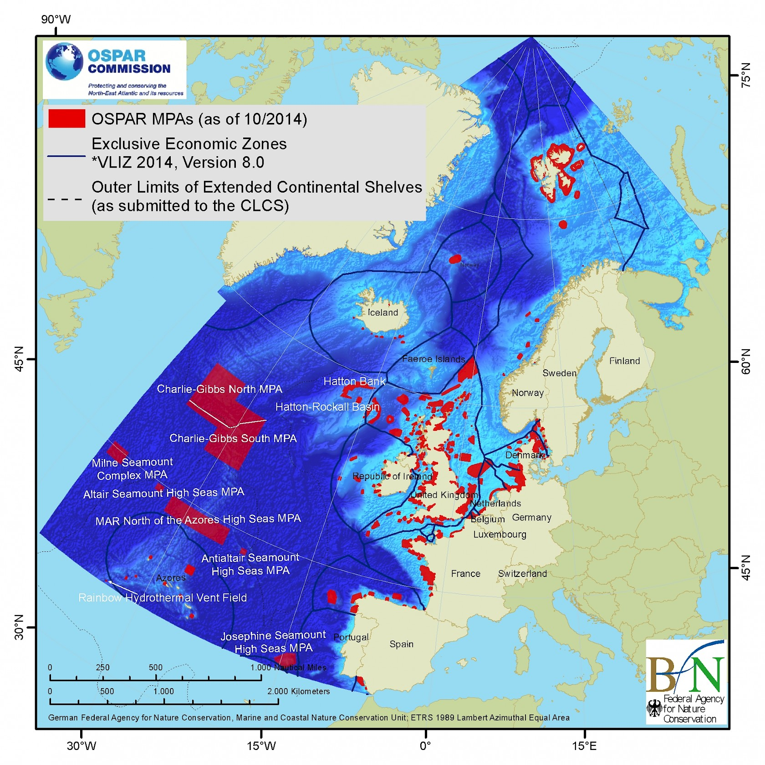


Example: North East Atlantic
OSPAR MPA network/NEAFC fisheries closures
The “Collective Arrangement”
Notes:
In this slide we present a schema for how the cycle could work – and for example how and when the mechanism for the transparency of action can feed into the cycle.
The process starts with the contributions that countries are currently preparing, framed and supported by the regime on means of implementation.
Once contributions are prepared, there would be a process to assess the adequacy of the contributions. It should be noted that this process can probably take place both inside and outside the UNFCCC. There should be a consultation in the UNFCCC, as many have proposed. It’s an open question whether there will be time and political scope for more before Paris. But there will also be researchers and experts that can help us to form an idea of the collective and individual adequacy of contributions. It’s also an open question of whether this process could result in revisions to contributions in T1.
Once determined, contributions would be implemented and there would be a process to ensure the transparency of action.
It is important to consider the implications of a short ‘contribution cycle’ for the role of the transparency process. Imagine we have a very short cycle of contributions, for example every 5 years. That means that we are back at the table well before the current period has ended (or indeed started). This is the case we have now, negotiating in 2015 contributions for post 2020, before the pre 2020 period has finished.
A key issue therefore becomes how can the transparency of action process also look forward to provide useful information for subsequent rounds of collective action?
The final step in the cycle is a process of collective and individual learning that would provide an input into the next round of contributions. This could combine elements of capacity building and facilitation, in order to help countries better prepare subsequent contributions, as well as identify on-going successes and difficulties in implementing the current period.
It should be noted that we don’t speak here of compliance. Conceptually, this could be kept separate from the learning and problem solving process. Certainly, it may be useful to have a clear, independent vision ex post of whether a contribution has been achieved, as a minimum. That is a topic for this afternoon.

Slide 9

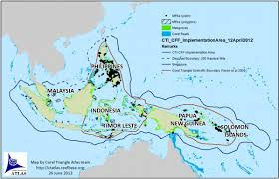
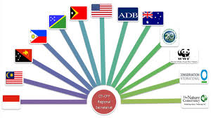
Example: The Coral Triangle
Notes:
In this slide we present a schema for how the cycle could work – and for example how and when the mechanism for the transparency of action can feed into the cycle.
The process starts with the contributions that countries are currently preparing, framed and supported by the regime on means of implementation.
Once contributions are prepared, there would be a process to assess the adequacy of the contributions. It should be noted that this process can probably take place both inside and outside the UNFCCC. There should be a consultation in the UNFCCC, as many have proposed. It’s an open question whether there will be time and political scope for more before Paris. But there will also be researchers and experts that can help us to form an idea of the collective and individual adequacy of contributions. It’s also an open question of whether this process could result in revisions to contributions in T1.
Once determined, contributions would be implemented and there would be a process to ensure the transparency of action.
It is important to consider the implications of a short ‘contribution cycle’ for the role of the transparency process. Imagine we have a very short cycle of contributions, for example every 5 years. That means that we are back at the table well before the current period has ended (or indeed started). This is the case we have now, negotiating in 2015 contributions for post 2020, before the pre 2020 period has finished.
A key issue therefore becomes how can the transparency of action process also look forward to provide useful information for subsequent rounds of collective action?
The final step in the cycle is a process of collective and individual learning that would provide an input into the next round of contributions. This could combine elements of capacity building and facilitation, in order to help countries better prepare subsequent contributions, as well as identify on-going successes and difficulties in implementing the current period.
It should be noted that we don’t speak here of compliance. Conceptually, this could be kept separate from the learning and problem solving process. Certainly, it may be useful to have a clear, independent vision ex post of whether a contribution has been achieved, as a minimum. That is a topic for this afternoon.

Slide 10

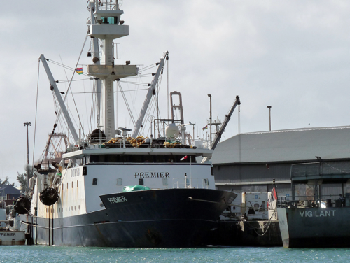
Example: East African Coast
Notes:
In this slide we present a schema for how the cycle could work – and for example how and when the mechanism for the transparency of action can feed into the cycle.
The process starts with the contributions that countries are currently preparing, framed and supported by the regime on means of implementation.
Once contributions are prepared, there would be a process to assess the adequacy of the contributions. It should be noted that this process can probably take place both inside and outside the UNFCCC. There should be a consultation in the UNFCCC, as many have proposed. It’s an open question whether there will be time and political scope for more before Paris. But there will also be researchers and experts that can help us to form an idea of the collective and individual adequacy of contributions. It’s also an open question of whether this process could result in revisions to contributions in T1.
Once determined, contributions would be implemented and there would be a process to ensure the transparency of action.
It is important to consider the implications of a short ‘contribution cycle’ for the role of the transparency process. Imagine we have a very short cycle of contributions, for example every 5 years. That means that we are back at the table well before the current period has ended (or indeed started). This is the case we have now, negotiating in 2015 contributions for post 2020, before the pre 2020 period has finished.
A key issue therefore becomes how can the transparency of action process also look forward to provide useful information for subsequent rounds of collective action?
The final step in the cycle is a process of collective and individual learning that would provide an input into the next round of contributions. This could combine elements of capacity building and facilitation, in order to help countries better prepare subsequent contributions, as well as identify on-going successes and difficulties in implementing the current period.
It should be noted that we don’t speak here of compliance. Conceptually, this could be kept separate from the learning and problem solving process. Certainly, it may be useful to have a clear, independent vision ex post of whether a contribution has been achieved, as a minimum. That is a topic for this afternoon.

Slide 11

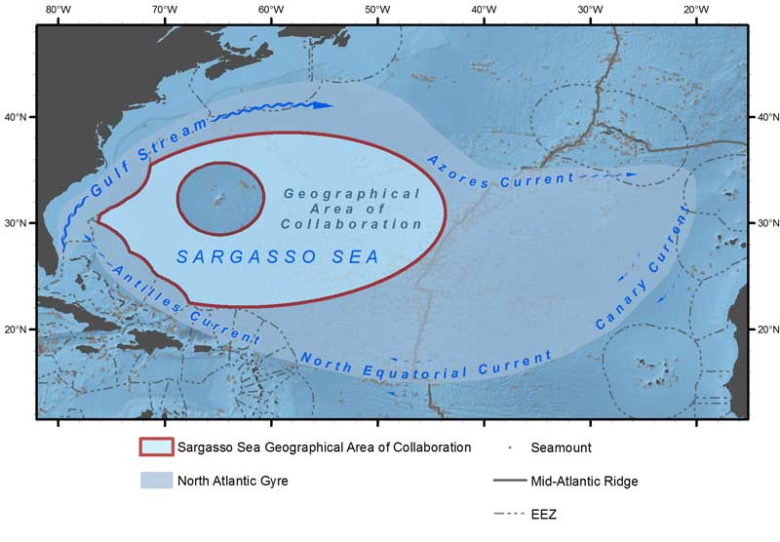
Example: Sargasso Sea
Notes:
In this slide we present a schema for how the cycle could work – and for example how and when the mechanism for the transparency of action can feed into the cycle.
The process starts with the contributions that countries are currently preparing, framed and supported by the regime on means of implementation.
Once contributions are prepared, there would be a process to assess the adequacy of the contributions. It should be noted that this process can probably take place both inside and outside the UNFCCC. There should be a consultation in the UNFCCC, as many have proposed. It’s an open question whether there will be time and political scope for more before Paris. But there will also be researchers and experts that can help us to form an idea of the collective and individual adequacy of contributions. It’s also an open question of whether this process could result in revisions to contributions in T1.
Once determined, contributions would be implemented and there would be a process to ensure the transparency of action.
It is important to consider the implications of a short ‘contribution cycle’ for the role of the transparency process. Imagine we have a very short cycle of contributions, for example every 5 years. That means that we are back at the table well before the current period has ended (or indeed started). This is the case we have now, negotiating in 2015 contributions for post 2020, before the pre 2020 period has finished.
A key issue therefore becomes how can the transparency of action process also look forward to provide useful information for subsequent rounds of collective action?
The final step in the cycle is a process of collective and individual learning that would provide an input into the next round of contributions. This could combine elements of capacity building and facilitation, in order to help countries better prepare subsequent contributions, as well as identify on-going successes and difficulties in implementing the current period.
It should be noted that we don’t speak here of compliance. Conceptually, this could be kept separate from the learning and problem solving process. Certainly, it may be useful to have a clear, independent vision ex post of whether a contribution has been achieved, as a minimum. That is a topic for this afternoon.

Slide 12
Enabling conditions
Some regions benefit from favourable enabling conditions that have allowed them to make impressive progress, while others have created such conditions through cooperation:
Strong existing legal and policy frameworks;
A history of active engagement of States in regional processes;
A clear & present economic/environmental imperative;
Long-term political and institutional stability;
Stakeholder engagement & community buy-in;
Availability of financing for capacity development.
Notes:
In this slide we present a schema for how the cycle could work – and for example how and when the mechanism for the transparency of action can feed into the cycle.
The process starts with the contributions that countries are currently preparing, framed and supported by the regime on means of implementation.
Once contributions are prepared, there would be a process to assess the adequacy of the contributions. It should be noted that this process can probably take place both inside and outside the UNFCCC. There should be a consultation in the UNFCCC, as many have proposed. It’s an open question whether there will be time and political scope for more before Paris. But there will also be researchers and experts that can help us to form an idea of the collective and individual adequacy of contributions. It’s also an open question of whether this process could result in revisions to contributions in T1.
Once determined, contributions would be implemented and there would be a process to ensure the transparency of action.
It is important to consider the implications of a short ‘contribution cycle’ for the role of the transparency process. Imagine we have a very short cycle of contributions, for example every 5 years. That means that we are back at the table well before the current period has ended (or indeed started). This is the case we have now, negotiating in 2015 contributions for post 2020, before the pre 2020 period has finished.
A key issue therefore becomes how can the transparency of action process also look forward to provide useful information for subsequent rounds of collective action?
The final step in the cycle is a process of collective and individual learning that would provide an input into the next round of contributions. This could combine elements of capacity building and facilitation, in order to help countries better prepare subsequent contributions, as well as identify on-going successes and difficulties in implementing the current period.
It should be noted that we don’t speak here of compliance. Conceptually, this could be kept separate from the learning and problem solving process. Certainly, it may be useful to have a clear, independent vision ex post of whether a contribution has been achieved, as a minimum. That is a topic for this afternoon.

Slide 13
Lessons learned
Regional contexts are highly diverse, but there are a number of common lessons learned:
Regional champions can play a major role;
Financing should be long-term, flexible, sustainable, and support both projects & capacity development;
Need for a common vision or purpose;
An appropriate institutional structure;
Targets and deadlines are necessary, but not sufficient. Need action, as well as words.
Notes:
In this slide we present a schema for how the cycle could work – and for example how and when the mechanism for the transparency of action can feed into the cycle.
The process starts with the contributions that countries are currently preparing, framed and supported by the regime on means of implementation.
Once contributions are prepared, there would be a process to assess the adequacy of the contributions. It should be noted that this process can probably take place both inside and outside the UNFCCC. There should be a consultation in the UNFCCC, as many have proposed. It’s an open question whether there will be time and political scope for more before Paris. But there will also be researchers and experts that can help us to form an idea of the collective and individual adequacy of contributions. It’s also an open question of whether this process could result in revisions to contributions in T1.
Once determined, contributions would be implemented and there would be a process to ensure the transparency of action.
It is important to consider the implications of a short ‘contribution cycle’ for the role of the transparency process. Imagine we have a very short cycle of contributions, for example every 5 years. That means that we are back at the table well before the current period has ended (or indeed started). This is the case we have now, negotiating in 2015 contributions for post 2020, before the pre 2020 period has finished.
A key issue therefore becomes how can the transparency of action process also look forward to provide useful information for subsequent rounds of collective action?
The final step in the cycle is a process of collective and individual learning that would provide an input into the next round of contributions. This could combine elements of capacity building and facilitation, in order to help countries better prepare subsequent contributions, as well as identify on-going successes and difficulties in implementing the current period.
It should be noted that we don’t speak here of compliance. Conceptually, this could be kept separate from the learning and problem solving process. Certainly, it may be useful to have a clear, independent vision ex post of whether a contribution has been achieved, as a minimum. That is a topic for this afternoon.

Slide 14
What’s next for regional ocean governance?
Regional ocean governance to play a key role in harmonising national approaches and increasing ambition
Development of regional partnerships for sustainable management of ocean
June conference a key step – partnership dialogues
Opportunities for region-to-region exchange
Notes:
In this slide we present a schema for how the cycle could work – and for example how and when the mechanism for the transparency of action can feed into the cycle.
The process starts with the contributions that countries are currently preparing, framed and supported by the regime on means of implementation.
Once contributions are prepared, there would be a process to assess the adequacy of the contributions. It should be noted that this process can probably take place both inside and outside the UNFCCC. There should be a consultation in the UNFCCC, as many have proposed. It’s an open question whether there will be time and political scope for more before Paris. But there will also be researchers and experts that can help us to form an idea of the collective and individual adequacy of contributions. It’s also an open question of whether this process could result in revisions to contributions in T1.
Once determined, contributions would be implemented and there would be a process to ensure the transparency of action.
It is important to consider the implications of a short ‘contribution cycle’ for the role of the transparency process. Imagine we have a very short cycle of contributions, for example every 5 years. That means that we are back at the table well before the current period has ended (or indeed started). This is the case we have now, negotiating in 2015 contributions for post 2020, before the pre 2020 period has finished.
A key issue therefore becomes how can the transparency of action process also look forward to provide useful information for subsequent rounds of collective action?
The final step in the cycle is a process of collective and individual learning that would provide an input into the next round of contributions. This could combine elements of capacity building and facilitation, in order to help countries better prepare subsequent contributions, as well as identify on-going successes and difficulties in implementing the current period.
It should be noted that we don’t speak here of compliance. Conceptually, this could be kept separate from the learning and problem solving process. Certainly, it may be useful to have a clear, independent vision ex post of whether a contribution has been achieved, as a minimum. That is a topic for this afternoon.

Slide 15

Glen Wright
Institute for Sustainable Development and International Relations (IDDRI)
glen.wright@iddri.org
Notes:
In this slide we present a schema for how the cycle could work – and for example how and when the mechanism for the transparency of action can feed into the cycle.
The process starts with the contributions that countries are currently preparing, framed and supported by the regime on means of implementation.
Once contributions are prepared, there would be a process to assess the adequacy of the contributions. It should be noted that this process can probably take place both inside and outside the UNFCCC. There should be a consultation in the UNFCCC, as many have proposed. It’s an open question whether there will be time and political scope for more before Paris. But there will also be researchers and experts that can help us to form an idea of the collective and individual adequacy of contributions. It’s also an open question of whether this process could result in revisions to contributions in T1.
Once determined, contributions would be implemented and there would be a process to ensure the transparency of action.
It is important to consider the implications of a short ‘contribution cycle’ for the role of the transparency process. Imagine we have a very short cycle of contributions, for example every 5 years. That means that we are back at the table well before the current period has ended (or indeed started). This is the case we have now, negotiating in 2015 contributions for post 2020, before the pre 2020 period has finished.
A key issue therefore becomes how can the transparency of action process also look forward to provide useful information for subsequent rounds of collective action?
The final step in the cycle is a process of collective and individual learning that would provide an input into the next round of contributions. This could combine elements of capacity building and facilitation, in order to help countries better prepare subsequent contributions, as well as identify on-going successes and difficulties in implementing the current period.
It should be noted that we don’t speak here of compliance. Conceptually, this could be kept separate from the learning and problem solving process. Certainly, it may be useful to have a clear, independent vision ex post of whether a contribution has been achieved, as a minimum. That is a topic for this afternoon.

